Slide 1
QUIZVERSE
REVOLUTIONIZING EXAMINATION EXPERIENCE
PROJECT GUIDE : Asst Prof SREEDEEPA H S
PRESENTED BY,
JELAN MATHEW JAMES
SUJITH T S
JOEL SIBY VARGHESE
N HARIKRISHNAN
SABARINATH O

Slide 2
INDEX
INTRODUCTION
OJECTIVES
LITERATURE SURVEY
FEATURES AND MODULES OF QUIZVERSE
DIAGRAMS
TIMELINE FOR IMPLEMENTATION
TECHNOLOGIES TO BE USED
CURRENT PROGRESS
FUTURE SCOPE
CONCLUSION

Slide 3
INTRODUCTION
Welcome to the presentation on QuizVerse, a revolutionary web application transforming the examination experience.
QuizVerse aims to address the shortcomings of traditional examination methods by offering a versatile platform for conducting rigorous examinations and engaging quizzes.
Our presentation will explore the challenges faced by traditional examination methods and how QuizVerse provides innovative solutions to overcome them.

Slide 4
OBJECTIVES
QuizVerse is a web application designed to revolutionize the examination experience.
QuizVerse offers a versatile platform for conducting rigorous examinations and engaging, knowledge-testing quizzes.
Application contains Faculty console for conducting tests and analysis of student performance.
Student role users can attend viva and submit their answers. Community role users can create general quizzes that can be accesses by others.

Slide 5
LITERATURE SURVEY
RESEARCH PAPERS
Neural sentence embedding models for semantic similarity estimation in the biomedical domain
2110.15708.pdf (arxiv.org)
Kathrin Blagec, Hong Xu, Asan Agibetov and Matthias Samwald
Talent-Interview: Web-Client Cheating Detection for Online Exams
2312.00795.pdf (arxiv.org)
Mert Ege, Mustafa Ceyhan
Using Sentence Embeddings and Semantic Similarity for Seeking Consensus when Assessing Trustworthy AI
[2208.04608] Using Sentence Embeddings and Semantic Similarity for Seeking Consensus when Assessing Trustworthy AI (arxiv.org)
Dennis vetter , Jesmin Jahan Tithi, Magnus Westerlund
RELATED APPLICATIONS
KAHOOT
https://kahoot.com/
Rapid Refresh by EdApp
https://www.edapp.com/rapid-refresh/

Slide 6
Overview of Traditional Examination Methods
Traditional examination methods, including Viva’s and MCQs, are time-consuming and stressful for learners.
These methods risk malpractices and fail to provide clear insights into students' limitations and weaknesses.
Challenges Faced in Traditional Examination Methods
Stress and anxiety among students due to traditional exams.
Proper documentation and analysis of student performance and exam details are difficult.
Risk of malpractices during traditional examinations.

Slide 7
Limitations of Existing Solutions
Security Concerns:
Vulnerabilities in authentication may lead to cheating or breaches in exam integrity.
Lack of robust encryption and data protection measures could compromise student privacy and assessment confidentiality.
Technical Issues:
Compatibility issues with different devices and browsers may disrupt the examination process for both educators and students
System downtime or slow performance during peak usage times could impede the smooth conduct of exams and result processing

Slide 8
Viva Examinations
General Quizzes
QuizVerse
Services
Educators can customize assessments to match specific learning goals and preferences. Viva examinations are adaptable by branch, semester, and time slot. Examiners input questions, and students receive a randomized subset. Including metadata about each question's module guides the randomization process.
Communities can create quizzes featuring both multiple-choice questions (MCQs) and short-answer questions, the latter being evaluated using natural language processing.

Slide 9
QUIZVERSE FEATURES

Slide 10
Admin
Admins oversee system operations, managing Institution and Community Admins.
Institution Admin
. Institution Admins handle faculty assignments, student creation, and course management.
User Roles and Permissions
Community admin
Community Admins initiate community-based quizzes.
Faculty
Faculty members can conduct exams, create question sets, select students, and analyse performance
Student
Students participate in exams and review their individual performance

Slide 11
Detailed Reports
Detailed reports break down student scores by module, enabling targeted improvement strategies.
Personalized metrics
Students can access personalized performance metrics based on their responses to module-specific questions
Advanced Analytics and Reporting
Export to Excel
Educators can export student scores to Excel for further analysis and intervention planning.

Slide 12
Secure Examination Environment
QuizVerse ensures a secure examination environment by implementing robust security measures and anti-cheating techniques
Randomized question bank
Mouse point tracking
Browser tab tracking
Time limits to uphold fair and reliable assessment outcomes.

Slide 13
Scalability and
Accessibility
QuizVerse is designed to be scalable and accessible, supporting a large number of users and accommodating divers learning needs.
Responsive Design for Accessibility
Responsive Design for Accessibility: Responsive design ensures that a web-based platform can be accessed from any device with an internet connection. This includes smartphones, tablets, laptops, and desktop computers. By making the design flexible, it accommodates users with different screen sizes and resolutions, enhancing the overall user experience and accessibility
Performance Optimization
Scalability involves optimizing the platform to handle increased loads efficiently. This includes optimizing code, database queries, and server configurations to ensure that the platform remains fast and responsive even as the number of users and data volume grows.

Slide 14
Integration with Learning Management Systems
QuizVerse seamlessly integrate with existing learning management systems (LMS), facilitating easy deployment and adoption within educational institutions, Integration features allow for synchronization of user accounts, course materials, and assessment data, streamlining administrative workflows

Slide 15
DIAGRAMS

Slide 16
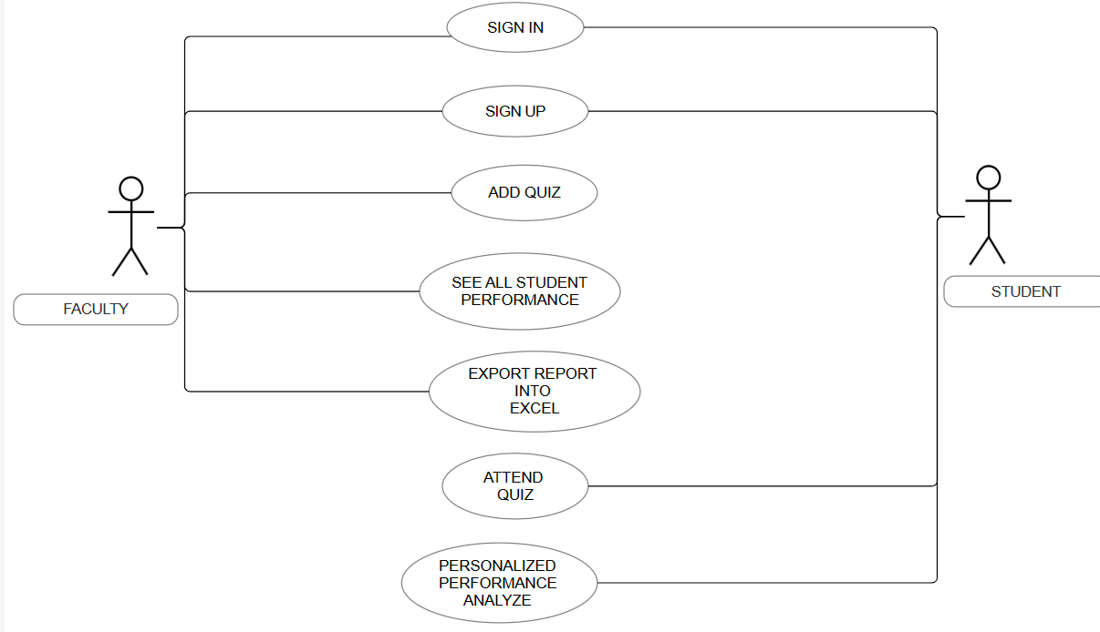
FACULTY – STUDEDNT USE CASE DIAGRAM

Slide 17
TIMELINE FOR IMPLEMENTATION
Week 1-6 : Planning and Initial Development
1
Week 1 : planning and requirements analysis
WEEK 1 : PLANNING AND REQUIREMENTS ANALYSIS
Define the core features and capabilities of the Quizverse
Detailing its functionalities ,limitations and goals
Document the specifications, requirements and objectives of project.
Assign roles and responsibilities within the development team.
2
Week 2: 6: frontend development
WEEK 2: 6: FRONTEND DEVELOPMENT
Set up development environment with Vite+React and Tailwind CSS.
Design wireframes and UI mockups using Figma.
Begin frontend development of user interfaces for different user roles (Admin, Faculty, Student, Community Admin),login system
3
Week 2: 6: backend development
Set up backend infrastructure using Python, Django, and Django Ninja.
Establish database schema and implement PostgreSQL for data storage.
Develop APIs for user authentication, exam creation, question management, analytics, etc.

Slide 18
4
Week 6: Integration and Testing
Integrate frontend and backend components.
Conduct unit tests for both frontend and backend functionalities.
Perform integration testing to ensure seamless communication between frontend and backend.
Week 7-10: Final Development, Testing, and Deployment
5
Week 7-8: Advanced Features and Security
Implement advanced features such as randomized question banks, time limits, and anti-cheating measures.
Enhance security measures including mouse point tracking and browser tab tracking.
Implement advanced features, such as natural language processing for short-answer questions
6
Week 9: Refinement and Testing
Refine user interfaces based on feedback from stakeholders and usability testing.
Perform thorough testing of all features and functionalities.
Address any bugs or issues identified during testing.

Slide 19
7
Week 10: Deployment and Documentation
Set up deployment environment using Docker, Docker Compose, and Nginx.
Deploy the application chosen cloud provider.
Conduct final testing to ensure the application is ready for production use.
Prepare documentation including user guides and technical documentation

Slide 20

TECHNOLOGIES TO BE USED

Slide 21



Front End
Advantages
Vite+React
Usage in Quizverse
Offers a fast development server and efficient build process, making it ideal for rapid development and prototyping. React's component-based architecture allows for reusable UI components, enhancing maintainability and scalability
Used to build the interactive quiz interface, including the dashboard, quiz pages, and user authentication components. React's state management and component lifecycle methods are leveraged to manage quiz states, user interactions, and dynamic content.
A collaborative design tool that allows for real-time collaboration, making it easier to design and iterate on UI/UX designs. It's particularly useful for creating wireframes, mockups, and prototypes.
Figma
Utilized for styling the application, ensuring a consistent and responsive design across different devices. It helps in quickly implementing the design system defined in Figma.
Provides utility-first CSS framework, enabling rapid UI development with customizable design systems. It's highly efficient for responsive design and reduces the need for custom CSS.
Tailwind CSS
Employed for designing the UI/UX of Quizverse, including the layout of the dashboard, quiz pages, and user authentication screens. It facilitates collaboration among designers and developers, ensuring a cohesive look and feel.

Slide 22



Back End
Advantages
Python
Usage in Quizverse
Known for its readability and simplicity, making it easier to maintain and scale the application. Python's extensive ecosystem provides a wide range of libraries and frameworks for various tasks.
The primary programming language used for backend development, leveraging its robust ecosystem for various functionalities like database management, authentication, and more.
Django
A high-level Python web framework that encourages rapid development and clean, pragmatic design. It includes an ORM (Object-Relational Mapping) for database interactions, authentication, and more, out of the box.
Used to build the core application logic, including user authentication, session management, and serving the static files for the front end. Django's ORM simplifies database interactions, making it easier to manage quiz data, user profiles, and other application data
A web framework for building APIs with Python 3.6+ type hints. It's designed to be fast and easy to use, making it ideal for creating RESTful APIs
Django Ninja
Employed to create the API endpoints for Quizverse, handling requests from the front end for quiz data, user actions, and more. It ensures efficient communication between the front end and the backend, facilitating the dynamic content loading and user interactions.

Slide 23


Advantages
PostgreSQL
Usage in Quizverse
Offers advanced features like full-text search, JSON support, and spatial data types, making it highly versatile for various types of data storage and querying needs. It's also known for its reliability, performance, and scalability.
Used as the primary database for storing quiz data, user profiles, quiz attempts, and other application data. Its powerful querying capabilities ensure efficient data retrieval and manipulation, supporting the dynamic and interactive nature of Quizverse.
Version Control
Git
A distributed version control system that allows for efficient tracking of changes, collaboration among developers, and easy rollback to previous versions if needed.
Used for tracking changes in the codebase, managing different versions of the application, and facilitating collaboration among developers.
A web-based hosting service for version control using Git. It facilitates collaboration, code review, and project management, making it easier to manage the development process of Quizverse.
GitHub
Employed for hosting the codebase, managing issues, pull requests, and documentation. It ensures that the development process is transparent and accessible to all team members.

Slide 24




Deployment
Docker
A cloud infrastructure provider offering scalable compute platforms with developer-friendly features. It's used for hosting the Quizverse application, ensuring high availability and scalability
Used to containerize the application, including the front end, back end, and database, ensuring consistency and ease of deployment across different environments.
DigitalOcean
Docker Compose
Docker Compose: A tool for defining and running multi-container Docker applications. It's used to manage the services (front end, back end, database) as a single entity, simplifying deployment and scaling.
Nginx
A high-performance HTTP server and reverse proxy server. It's used to serve the static files for the front end and as a reverse proxy for the backend, improving performance and security.

Slide 25
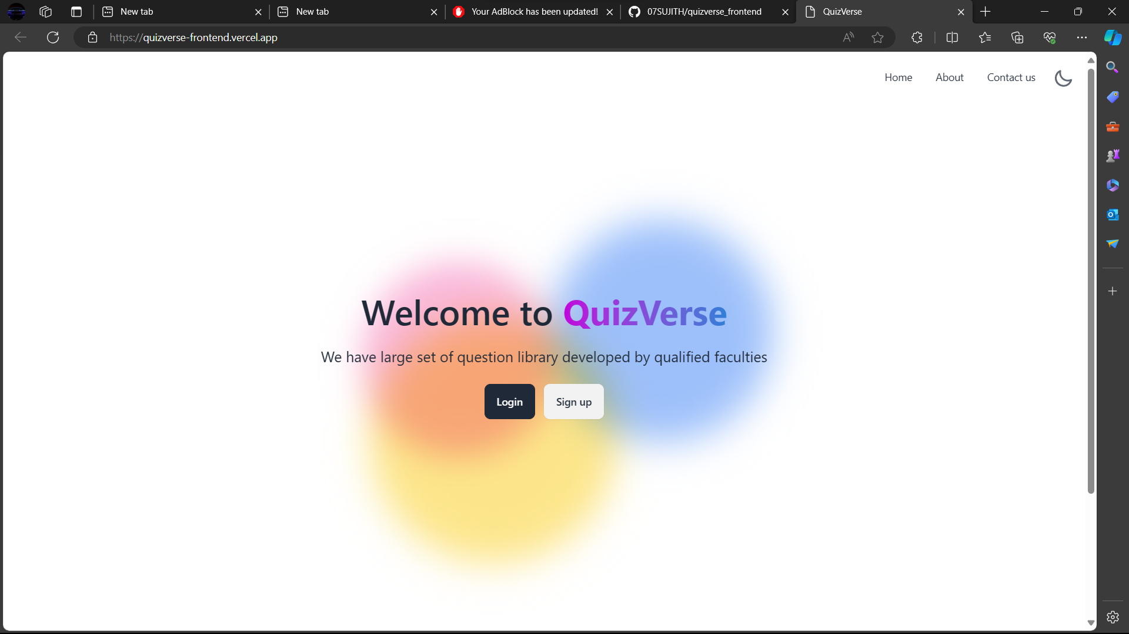
CURRENT PROGRESS

Slide 26
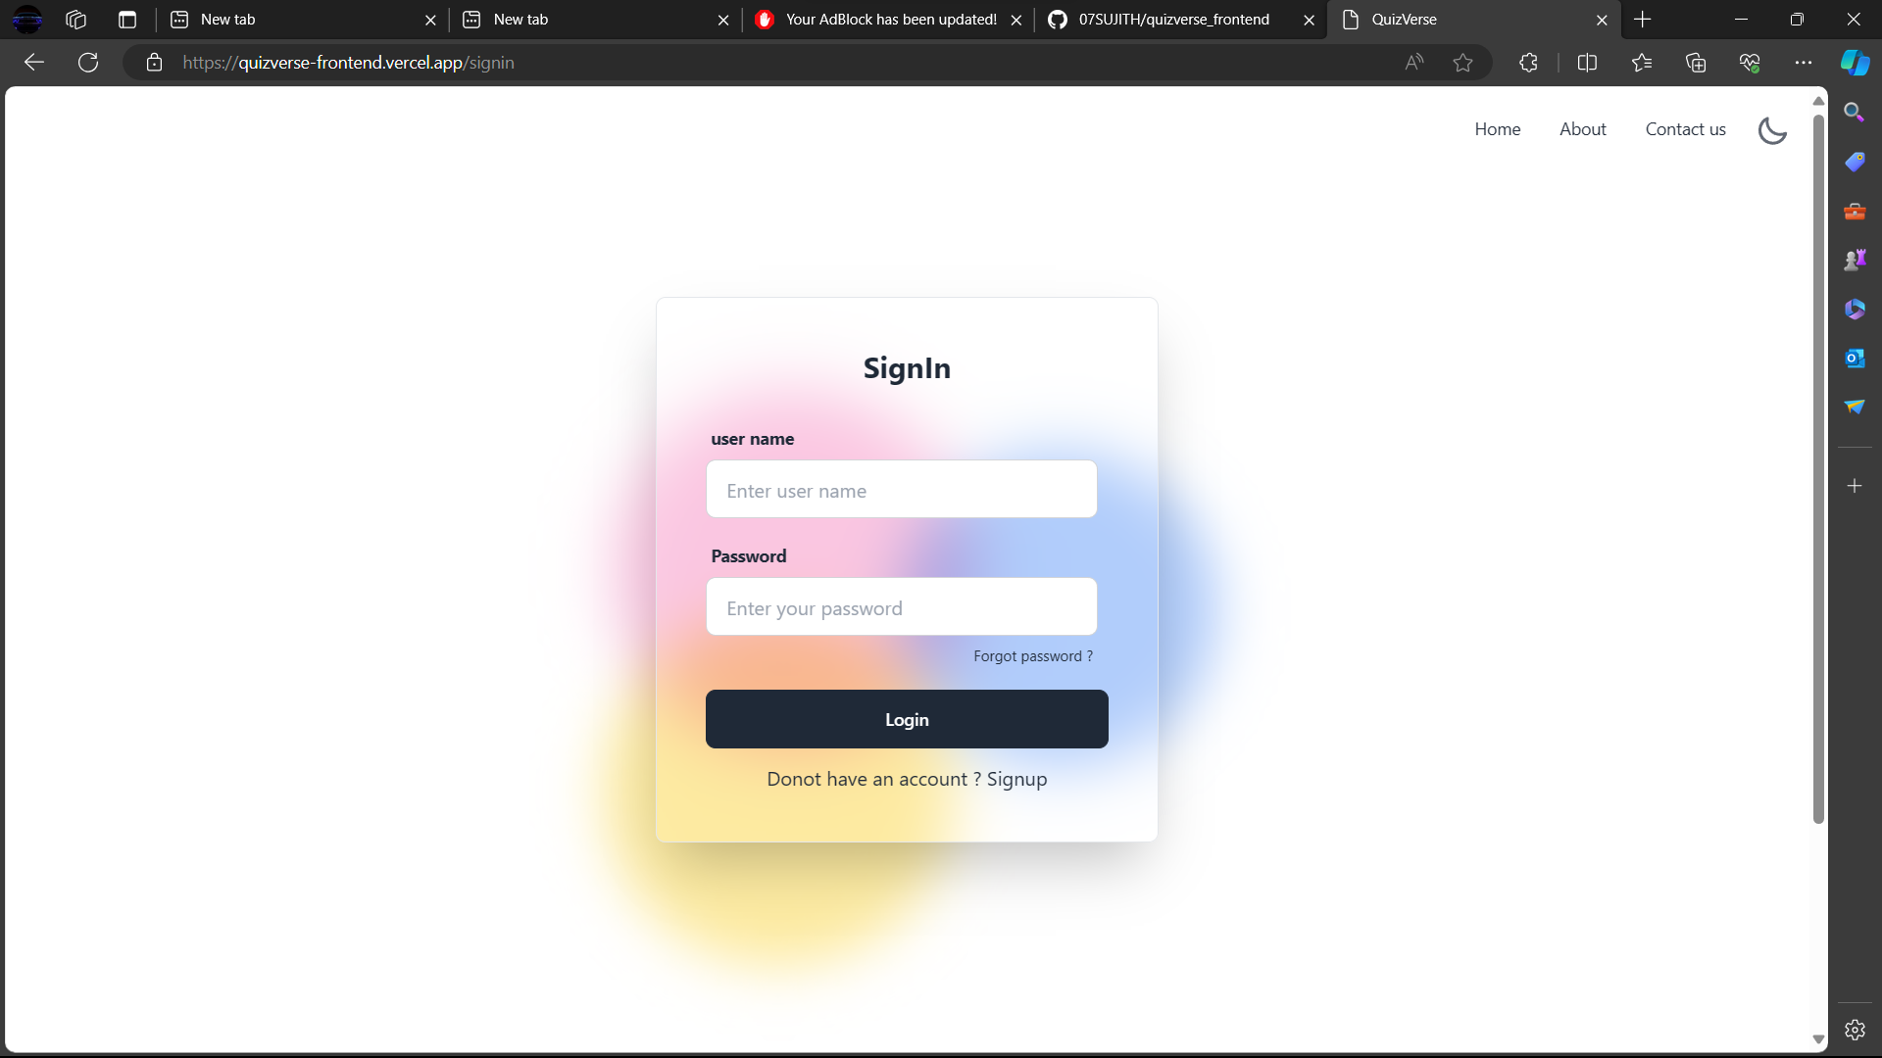

Slide 27
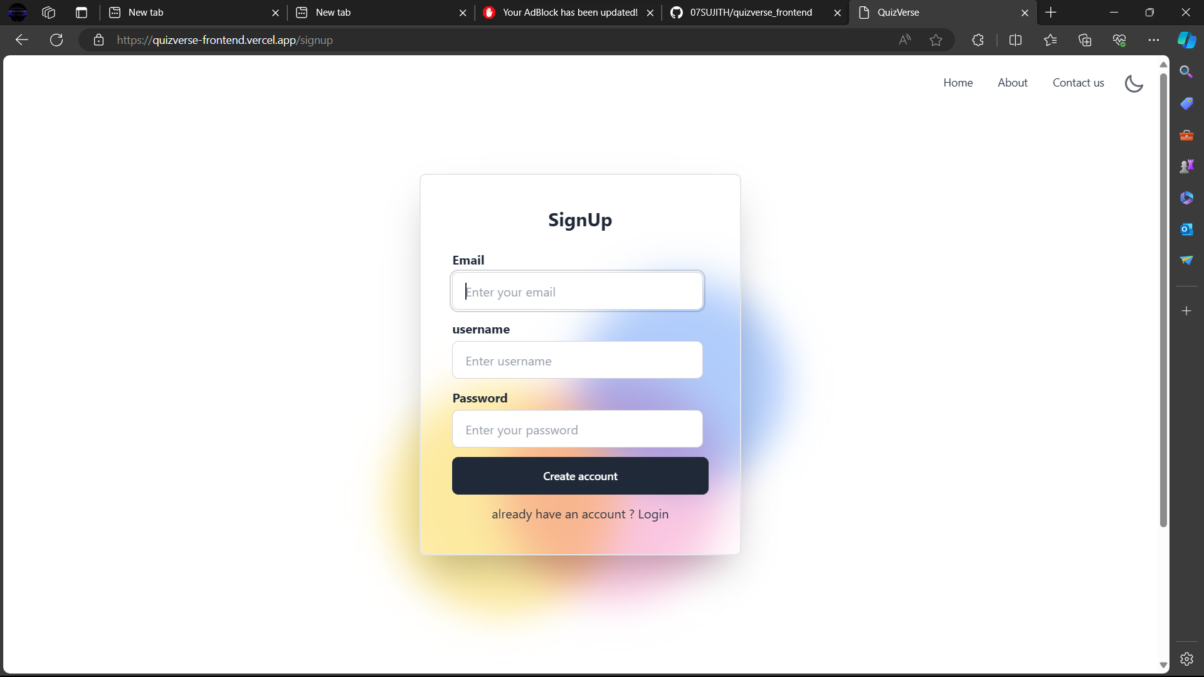

Slide 28
GIT HUB LINKS :
jelanmathewjames/quizverse_frontend (github.com)
jelanmathewjames/quizverse_backend (github.com)

Slide 29
Future Scops
In the future, QuizVerse aims to enhance the examination experience through advanced AI algorithms that personalize exams based on each student's learning style and proficiency level. It also plans to incorporate gamification elements like leaderboards and rewards to boost engagement and foster collaboration. Additionally, QuizVerse seeks to integrate augmented reality technology for immersive learning experiences, expand assessment formats beyond traditional methods, and implement robust security measures to maintain integrity. Furthermore, it aims to promote global collaboration and knowledge sharing by facilitating the creation and sharing of content across institutions, fostering a rich ecosystem of shared knowledge.

Slide 30
In summary, QuizVerse offers a fresh approach to exams that tackles the problems with traditional methods. It makes tests easier for teachers and more enjoyable for students. With its user-friendly design and strong security features, QuizVerse provides valuable insights into how well students are doing. By embracing QuizVerse, we're moving towards a future where exams are smarter, easier, and more inclusive, helping everyone learn better.
CONCLUSION

Slide 31
THANKYOU

